Slide 1


Evidence-Based Patient Advocacy Activities in Latvia
Olga Valciņa
Melanoma patient network of Latvia
“Step Ahead of Melanoma”
Latvian Association of Oncology Patient Organizations
“OncoAlliance”

Slide 2
Why am I Here?
Melanoma patient since 2017
  At the time of diagnosis, none of the innovative medicines for the treatment of melanoma were available in Latvia
"Step Ahead of Melanoma" was founded in 2019
OncoAlliance was founded in 2021
  OncoAlliance is the umbrella organization that brings together various organizations of patients with different types of cancer and aims to implement evidence-based advocacy for patient interests and rights
In my "normal" life, I am a microbiologist;
A degree in Medical Microbiology and scientific thinking is probably a good start for patient advocacy

Slide 3

Cancer Care Gap Between and in Countries
Affects Survival
Worsens the symptom burden
Decreases the/your willingness to pay
Limits the ability to adhere to an appropriate treatment plan
Reduces public trust in the country and the healthcare system
Increases stigma
Reduces screening rates
  why go for screening if there is no treatment in my country anyway

Slide 4
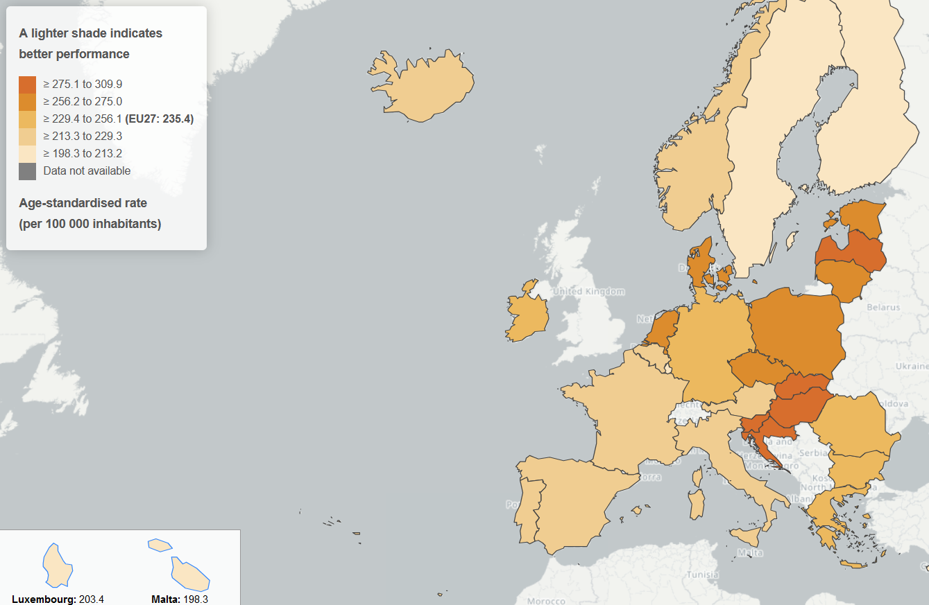
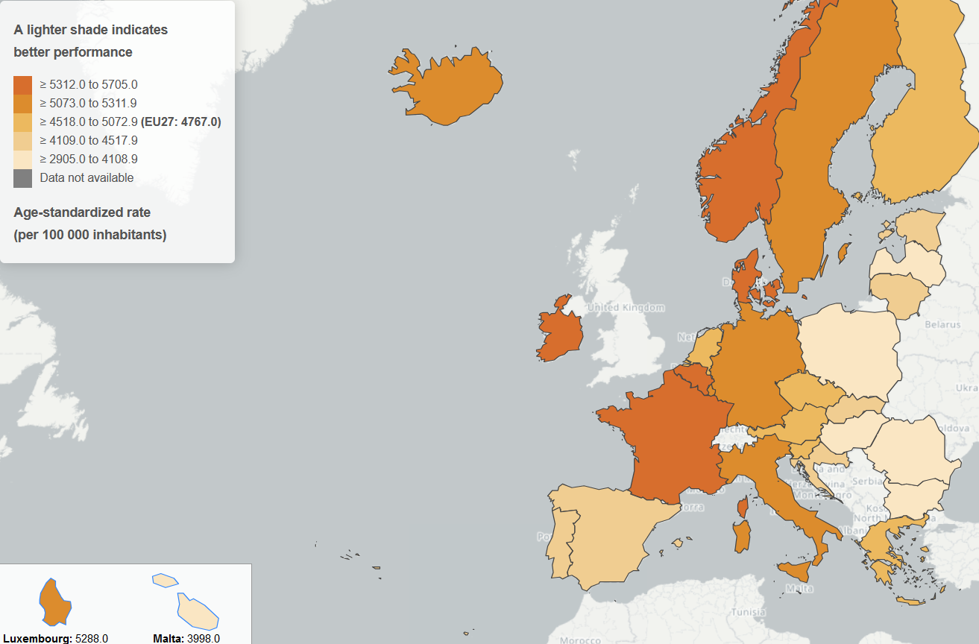
European Cancer Inequalities Registry
All cancers mortality, 2021
Cancer prevalence, 2020
The European Cancer Inequalities Registry is a flagship initiative of Europe's Beating Cancer Plan.
https://cancer-inequalities.jrc.ec.europa.eu/data-tool-by-country?ind=ALLMORT&ft=TOTAL

Slide 5
Cancer Mortality Rates Vary Widely Across Regions
OECD Country profile, Latvia, 2023

Slide 6
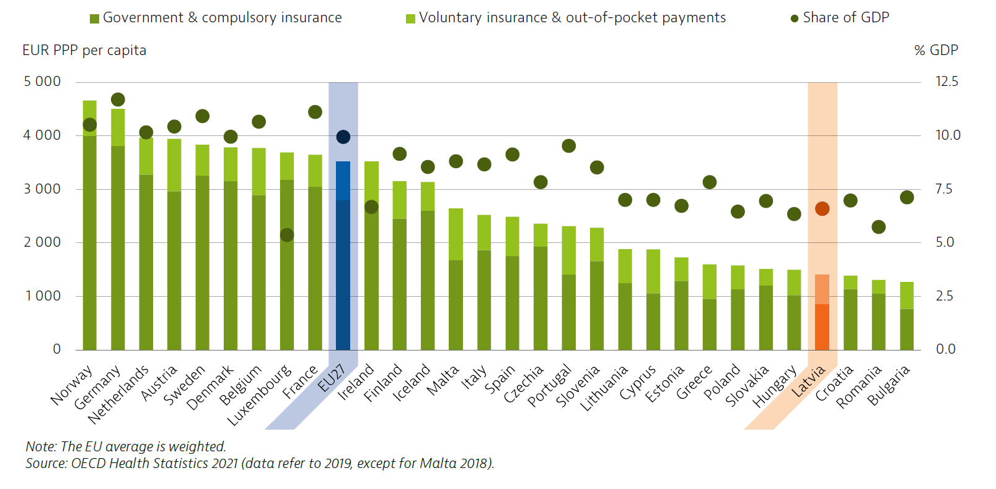
Health spending in EU
[Country Health Profiles 2021]

Slide 7
Equality and Equity
What is the Difference?

Slide 8

https://www.bath.ac.uk/guides/inclusive-leadership/

Slide 9
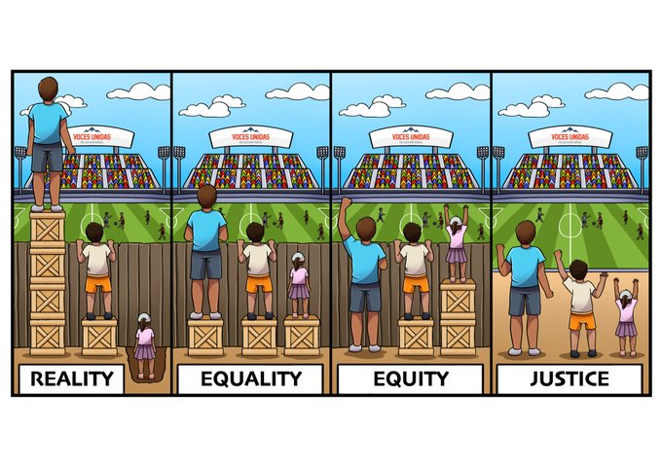
The A-Z of Social Justice Physical Education: Part 1
Article in Journal of Physical Education, Recreation & Dance · April 2020
DOI: 10.1080/07303084.2020.1724500

Slide 10


Slide 11
Collect
Evidence
Information
Knowledge
Opinions
Ideas
Right persons
Analyse
What is the problem?
What is the cause?
Why did this happen?
How to improve this?
Who to talk to?
Who is in charge?
Design
Design Solution
Create new opportunities
Eliminate the causes
Create a situation where the patient is the one who requests

Slide 12
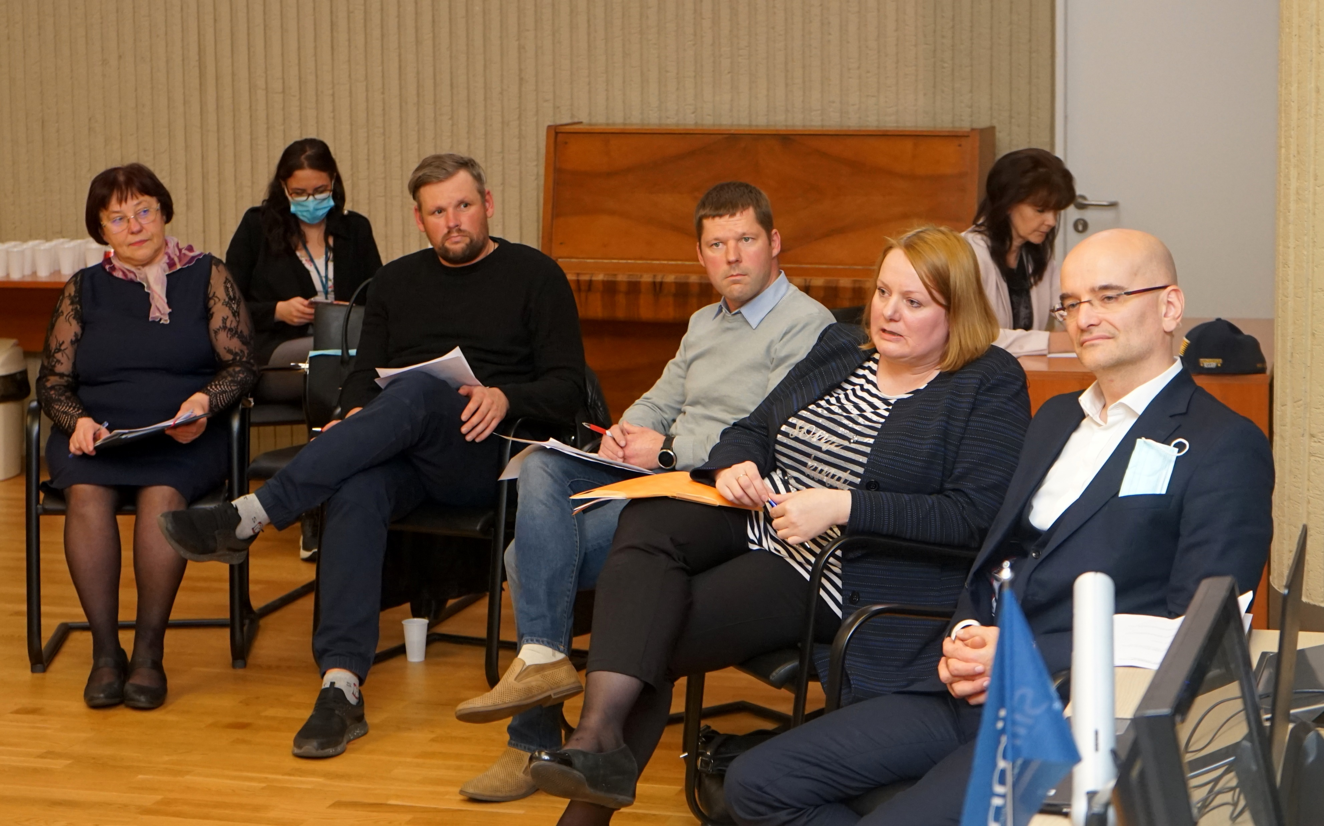

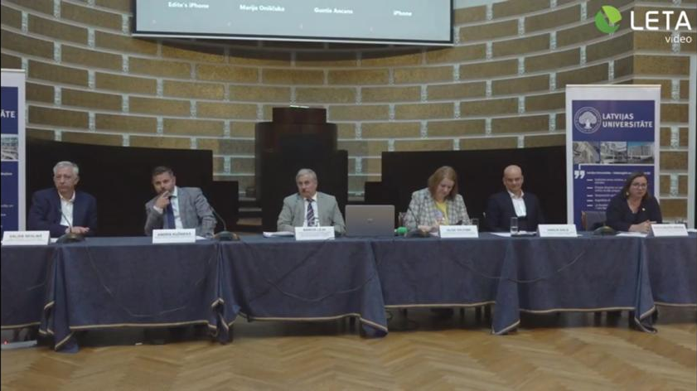
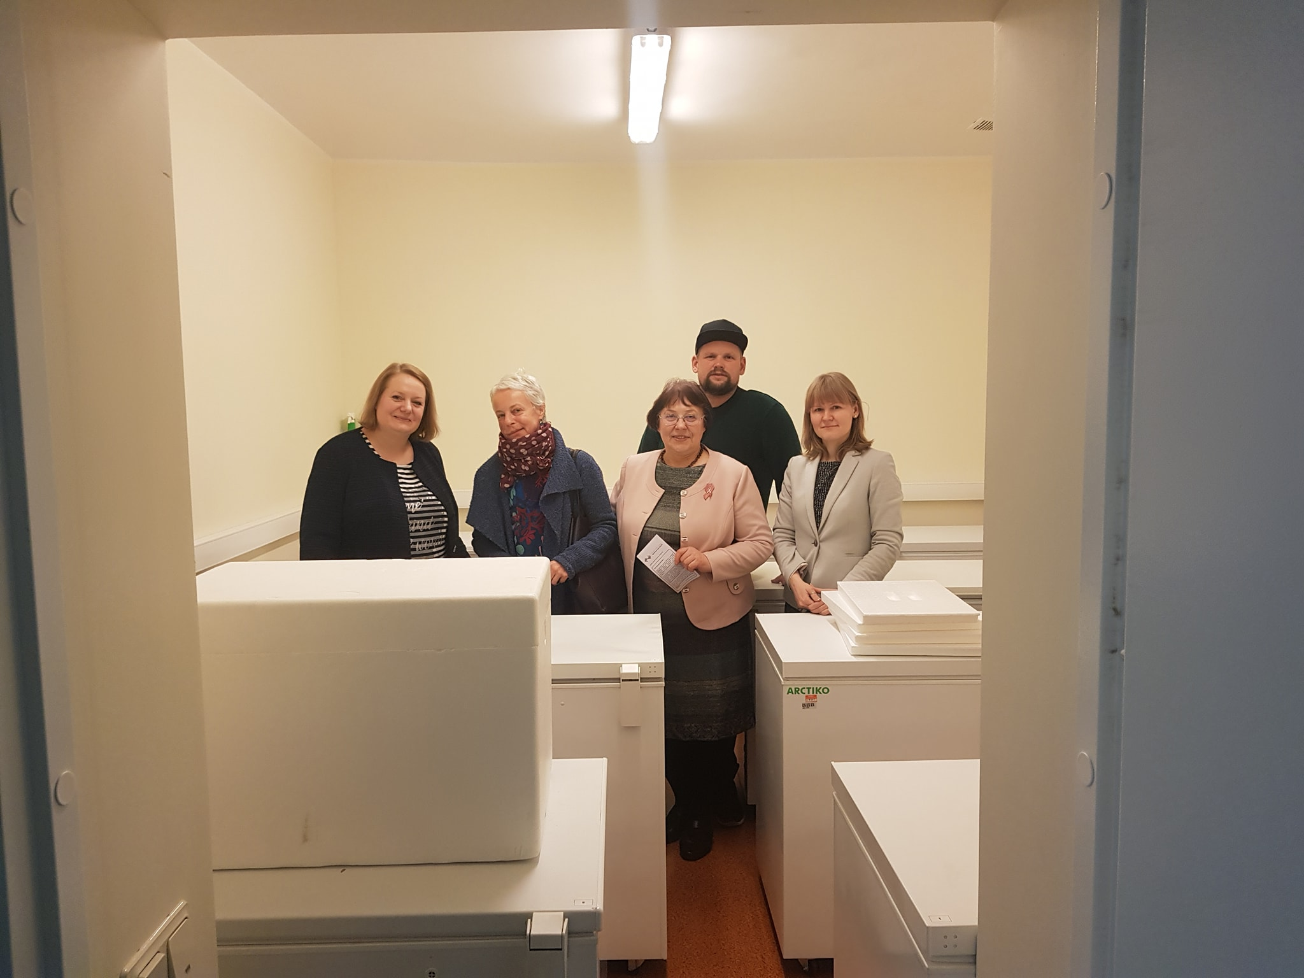
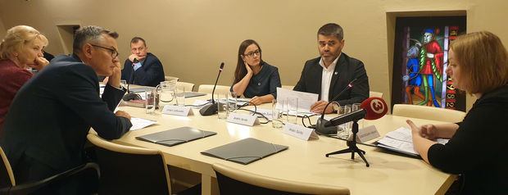
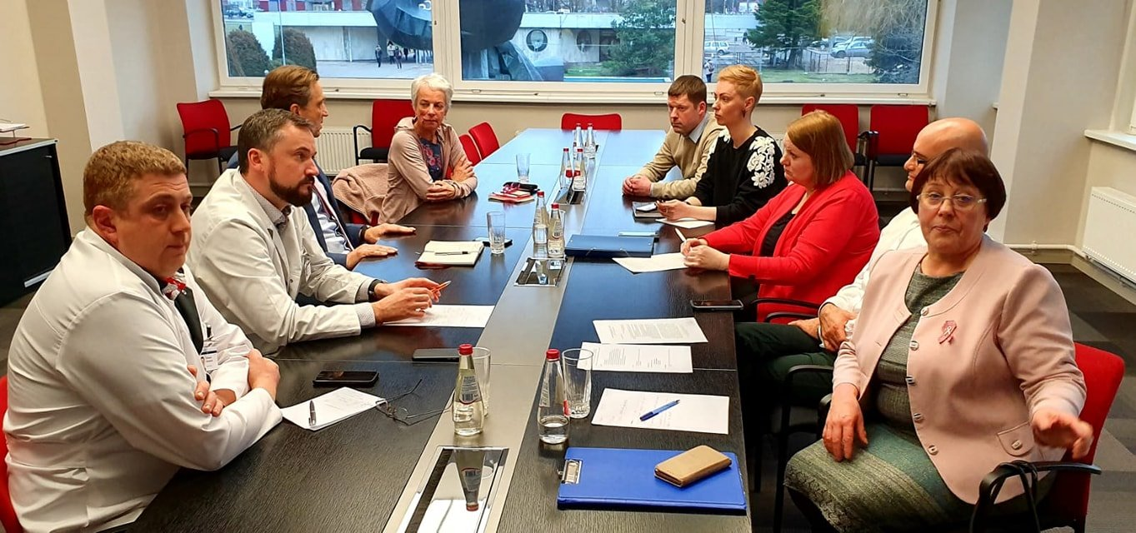
How does it Look?

Slide 14
Minimum Caseload
Optimal Number of Mammography Readings
The ECIBC's Guidelines Development Group (GDG) suggests that mammography readers read between 3 500 and 11 000 mammograms annually in organised population-based screening programmes
Programmes should continue to monitor the number of readings by readers and the quality indicators of the reading process
The requirements of a specialist breast centre:
  Minimum caseload for core MDT members:
    Breast radiologist: 1000 mammographic exams (5000 for breast radiologists participating in a centralised screening programme),
    200 breast ultrasounds and 50 magnetic resonance imaging (MRI) studies and 50 breast guided interventions per year
  Breast radiographer: 1000 mammograms per year
  https://www.sciencedirect.com/science/article/pii/S0960977620300606?via%3Dihub

Slide 15
Consequences of Non-Structured Pathology Reports

Slide 16
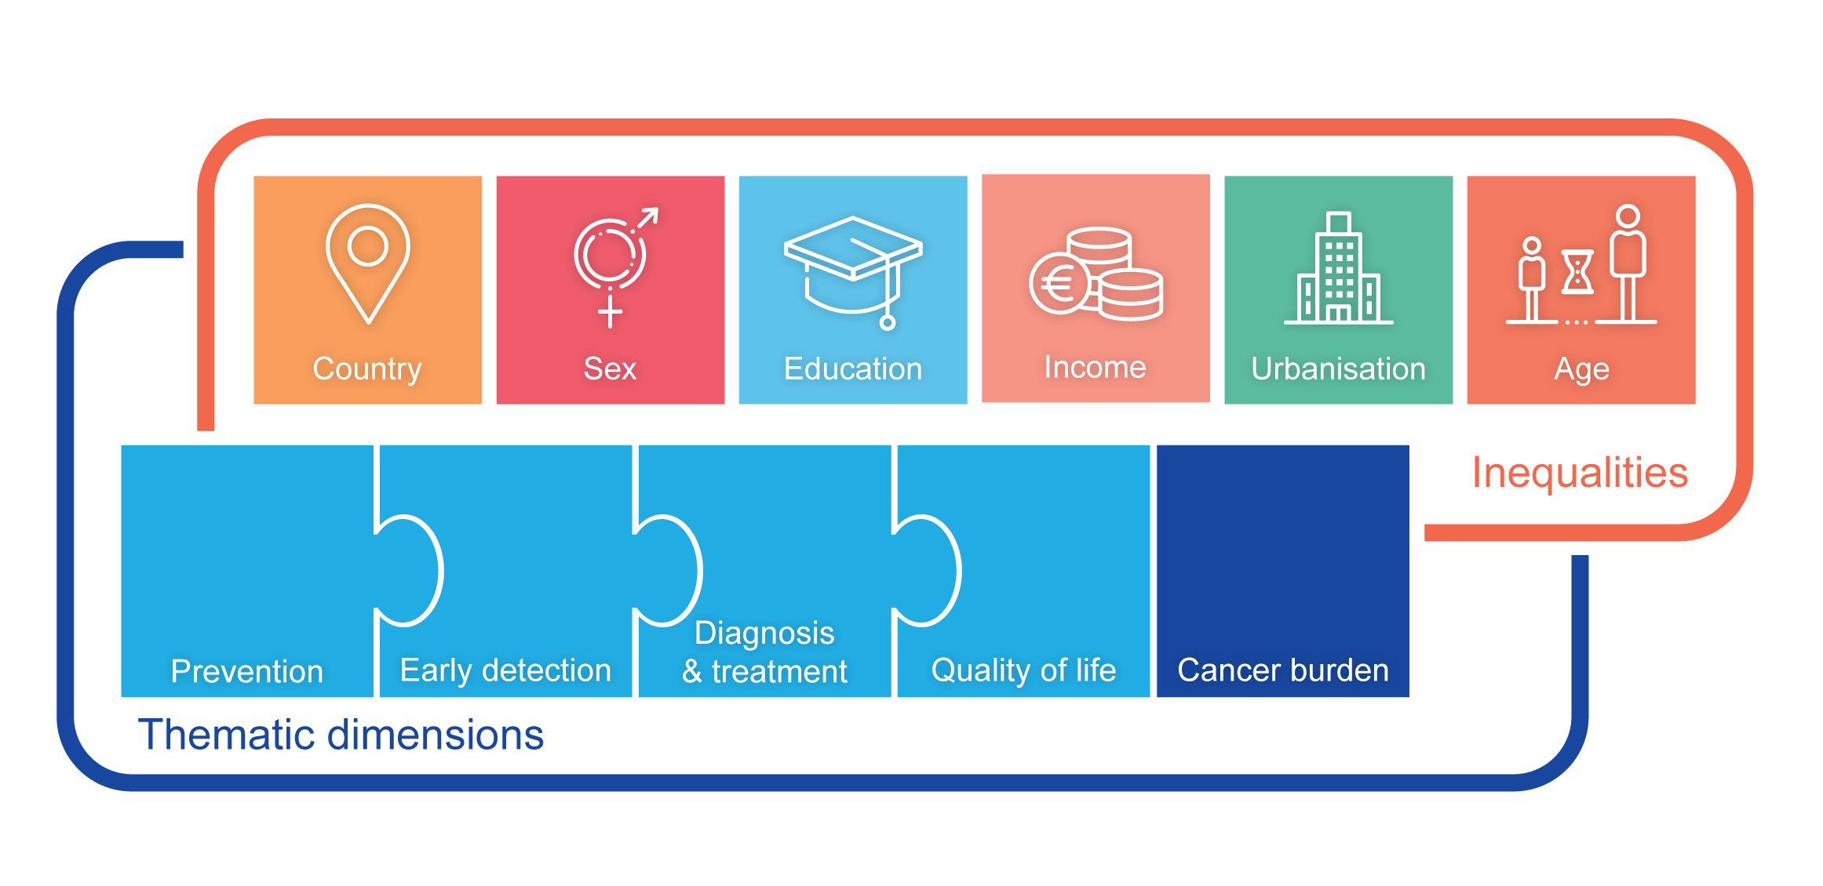
European Cancer Inequalities Registry
Beginning of data collection
We would like to compare mortality for specific tumors by stage and specific genetic types at the time of cancer diagnosis
Quality of life measurements and indicators
Data should be collected on:
  Access to treatment
  Access to genetic tests
  financial toxicity and social protection
  out-of-pocket payments and “informal” payments

Slide 17


Where to go?
Clear and mandatory minimum quality requirements
  Compulsory accreditation for all cancer centres and laboratories
  Proficiency tests and auditing
  Implementation of ECCO essential requirements for quality cancer care
  Clear action if inequality can be addressed immediately

Slide 18
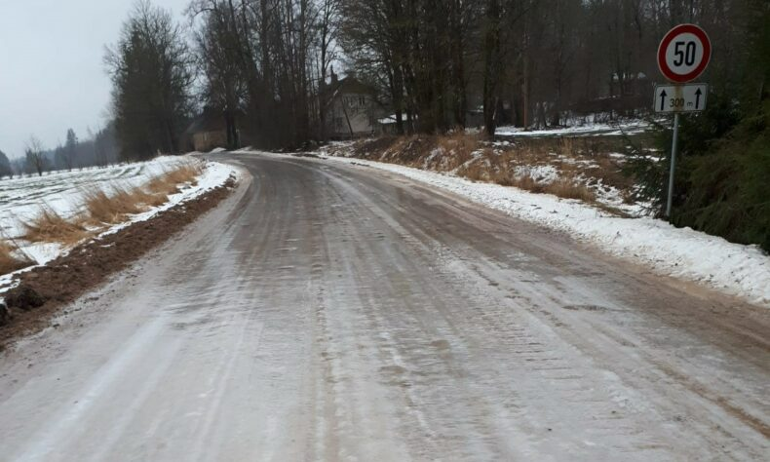
What do we Expect?
The contract for the state-reimbursed service should be concluded only with institutions that can meet the quality criteria
  the testing/screening method, double reading, minimum caseload, data reporting etc.
The contract should include all the essential quality requirements to pay state-reimbursed services to the medical institution
A system should be established that monitors and controls the fulfillment of quality requirements
https://staburags.lv/slideno-lauku-celu-del-sunakstei-brauc-ar-likumu/
Adressing local challenges:
  Weak public transport system - services inaccessible to patients in remote regions
  Regional roads are poorly maintained, especially in winter, making mobile mammography machines even more inaccessible
  Incompatible databases - insufficient involvement of family doctors

Slide 19
Melanoma patient network of Latvia
“Step Ahead of Melanoma”
https://soliprieksamelanomai.lv/
www.melanoma.lv
Latvian Association of Oncology Patient Organizations
“OncoAlliance”
https://onkoalianse.lv/lv/
https://www.pacientuakademija.lv/

