Slide 1


Supporting
over 50.000
cancer patients
e ery month

Slide 2

Lithuanian Cancer Patient Coalition
POLA
One of the largest umbrella non-governmental organisations in Lithuania
Operational since 2012-01-03
Uniting 30 oncology-related NGOs, including cancer patients' societies and organisations, providing assistance to people affected by cancer
Representing community of more than 55 000 cancer patients, who applied for POLA card membership and are registered in the POLA database

Slide 3

POLA activities are carried out in accordance with the 10 objectives set in the POLA Strategy
1. Educate General Society about cancer prevention
2. Continue develop cancer patients’ mentorship and navigation system
3. Ensure that no one feels left alone after cancer diagnosis – promote the POLA community
4. Encourage and educate patients and their family members to actively engage in their treatment and encourage for shared-decisions
5. Provide members of the POLA community with access to the individualized support they need
6. Develop partnerships with businesses to help cancer patients and their families acquire necessary goods and services at reduced or no cost
7. Develop partnerships with cultural institutions, granting POLA card holders and their families free or discounted access to cultural events
8. Continuously share relevant and useful information for patients through various communication channels
9. Advocate for the interests of cancer patients and strive for decisions that improve the situation of the cancer patient community
10. Strengthen POLA’s administrative capacity, ensure sustainability, and maintain transparency and accountability of the organization

Slide 4
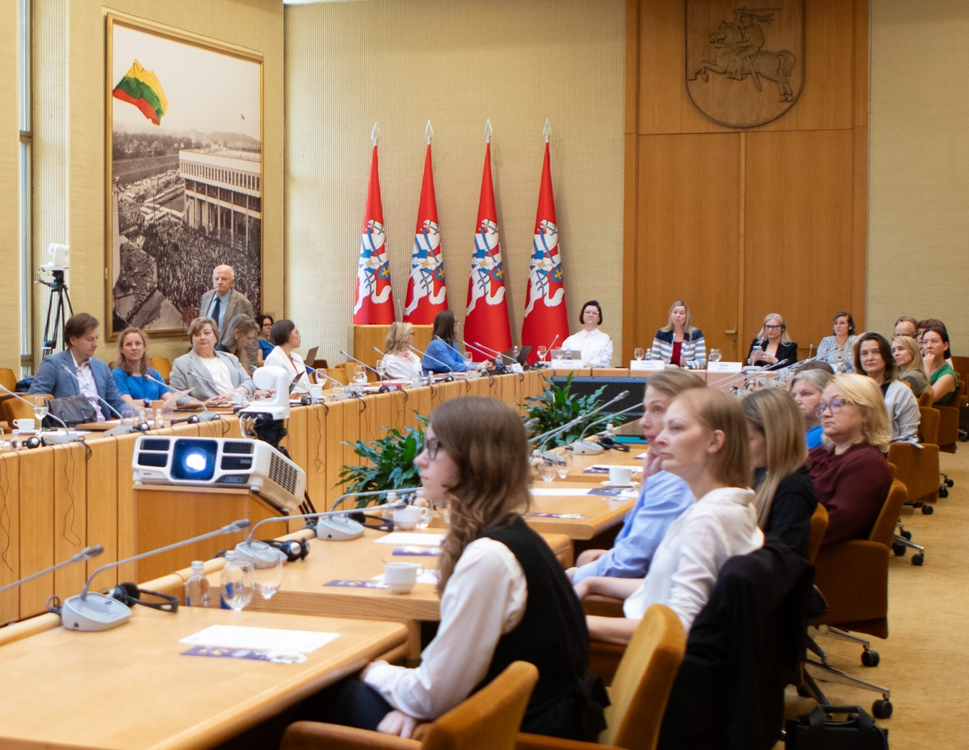



10. PACIENTŲ
TEISIŲ ADVOKATACIJA
Patient Advocacy
Ongoing collaboration with the Lithuanian Medical Workers Association, the Family Physicians’ Trade Union, the Young Doctors' Association, the Chamber of Dentists, the National Health Insurance Fund and all Oncology Centers
Continued participation in inter-institutional working groups and commissions, including those related to medicine reimbursement
New activity – Leading the Patient Council of the National Cancer Center
Proposals, Surveys, Coverage in mass media
In 2024 more than 20 official letters were submitted, participation in 9 inter-institutional bodies was ensured, in more than 50 different meetings the patient interests were expressed
Four surveys were performed: 1 On the need for a second medical opinion; 2. On the oral health of cancer patients; 3. On the state of personalized medicine in Lithuania and patients’ expectations; 4. On the evaluation of POLA's activities in 2024
POLA was mentioned in the mass media 244 times (2023 – 189 times; 2022 – 173 times; 2021 – 143 times; 2020 – 162 times; 2019 – 153 times)

Slide 5
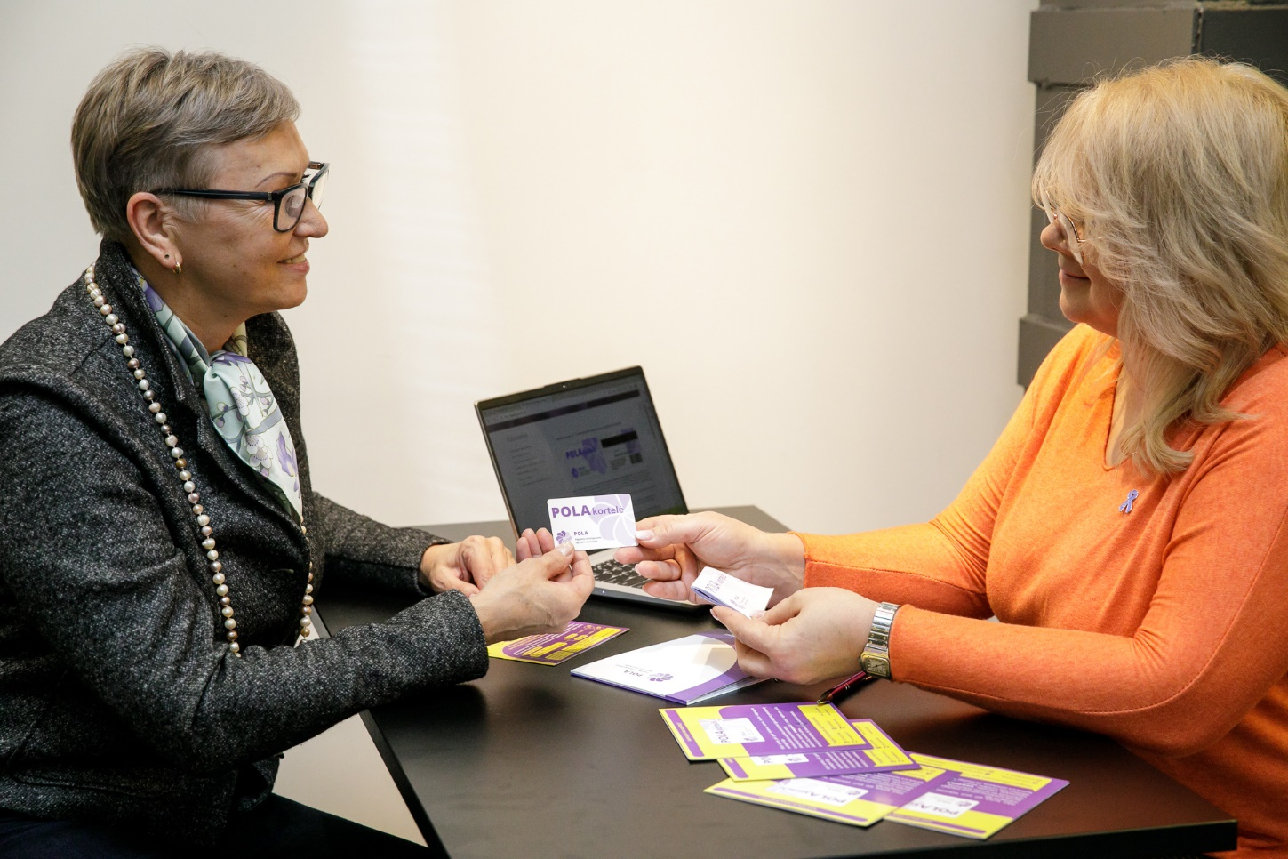
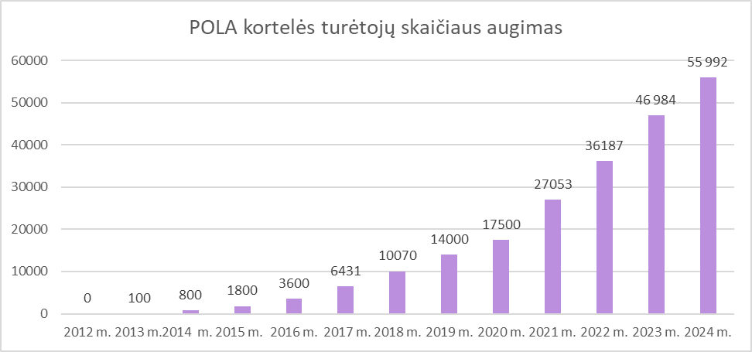
Growing comMunity of POLA CARD holderS
The card is issued in 40 cities across Lithuania
by POLA volunteers.
Also online application is possible since November 2020
POLA card initiative t is implemented since 2013.
In 2024 the POLA card has been awarded by the President of Lithuania as one the “the Power of Lithuania” initiatives for Improving the quality of life of cancer patients.
CARD BENEFITS
Cancer patients receive a free POLA card, allowing them to take advantage of discounts on various goods and services, receive invitations to cultural and educational events, receive free counseling, and get relevant information by e-mail or SMS.
Growth of the POLA Community
Statistics
Currently – almost 60 000 POLA card holders
During a year – more than 9000 new POLA card holders
More than 174 cooperation agreements with businesses and 32 with cultural institutions.
An average of 12 000 invitations for free admission to more than 400 concerts and performances a year,
About 800 free individual specialist consultations a year.
An average savings €20 - €50 each month thanks to the POLA Card

Slide 6
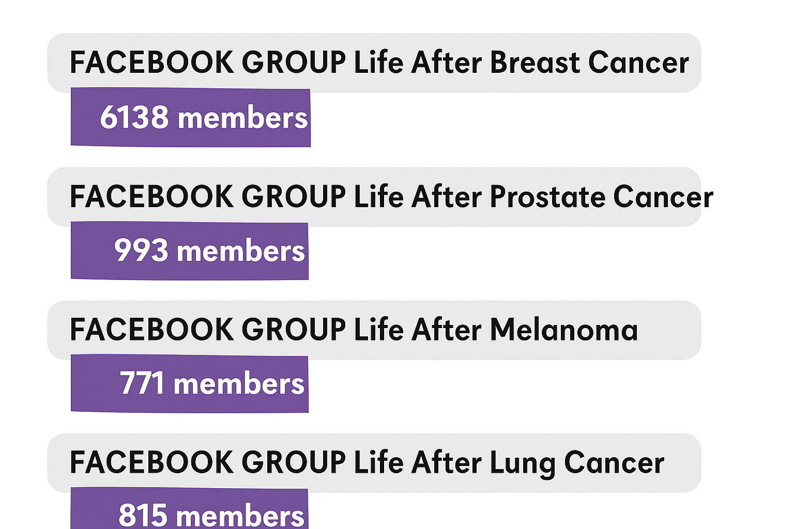
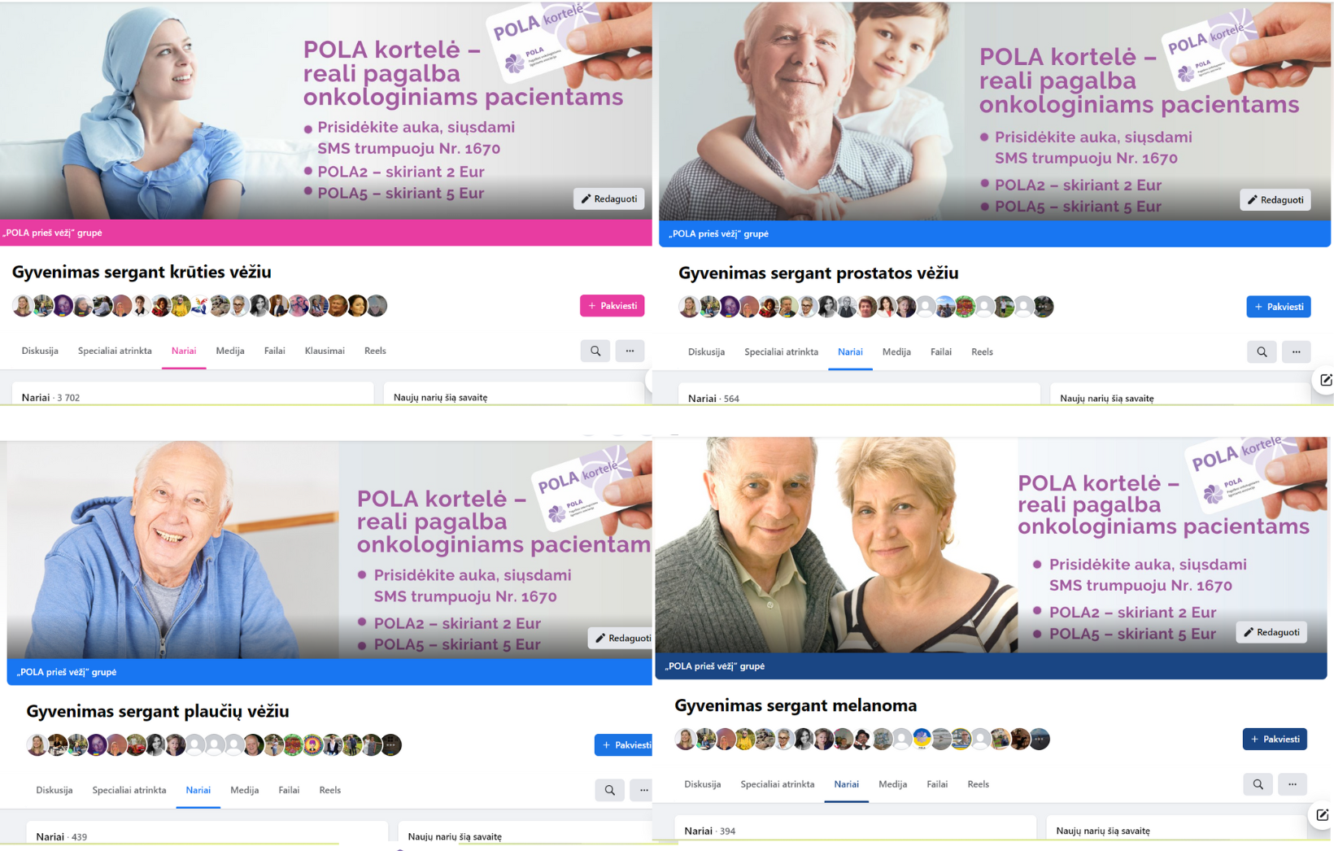
FOUR ACTIVE AND CARING PATIENT COMMUNITIES
ON FACEBOOK
Since 2020 more than 8000 persons diagnosed with breast, lung, prostate cancer and melanoma were brought together to active and caring patient communities on Facebook

Slide 7
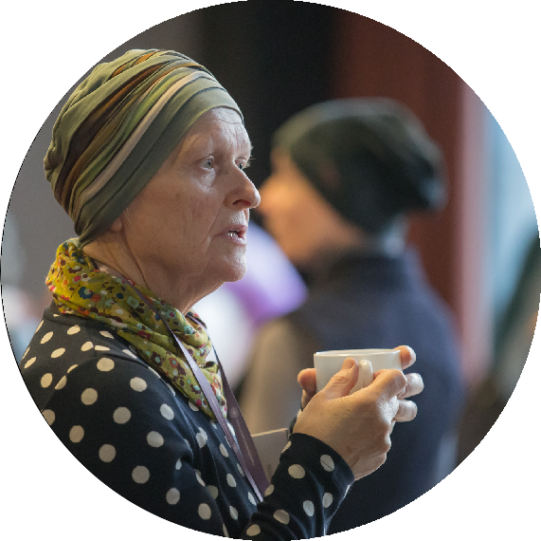

COUNCELLING
Legal Consultations
Cancer patients and their relatives often have questions about disability status, compensation, and social guarantees. To ensure the rights of oncology patients, since 2017 qualified POLA lawyers offer free legal counselling.
Psychological Support
Since 2017 POLA provides free psychological consultations to cancer patients and their relatives, as it is easier to recover together.
Advice on Nutrition
The majority of cancer patients are not sure how to improve their diet and lifestyle both during and after treatment, therefore since 2019 POLA provides free professional advice on diet and lifestyle.
Since 2017, POLA provides with free advice
for cancer patients and their families
734 consultations provided in 2024:
Psychologist | 295
Nutritionist | 270
Legal | 169
https://pola.lt/konsultacijos/

Slide 8
POLA contributes to bringing together the capacity of professionals and patient organizations at the EU level
EU CAYAS NET
EU4H-2021-PJ-04
European Network
of Youth Cancer Survivors
36 Partners
Sept. 2022 – August 2024
ONCOSCREEN
HORIZON-MISS-2021-CANCER-02-01
European “Shield” Against
Colorectal Cancer
38 Partners
Jan. 2023 – Dec. 2026
ONCODIR
HORIZON-MISS-2022-CANCER-01-01
Evidence-based Participatory Decision Making For Cancer Prevention through Research
27 Partners
June 2023 – Nov. 2026
MELIORA
HORIZON-MISS-2023-CANCER-01-02
Multimodal Engagement and Sustainable Lifestyle Interventions Optimising Breast Cancer Risk Reduction
16 Partners
Jan. 2024 – Dec 2026
READI
An IHI-funded project aimed at fostering a more cohesive and integrated clinical studies ecosystem for underserved and underrepresented communities
73 Partners
(Sept. 2024 – August 2030)

Slide 9

































OUR SPONSORS
OUR PARTNERS

Slide 10
More information:
www.pola.lt
www.priesvezi.lt
www.beatcancer,eu
neringa@pola.lt

