Slide 1
The right to be forgotten for cancer survivors
Why it is needed, how to adopt it?
Ines Aoufi on behalf of Dr. Françoise Meunier, MD, PhD, FRCP (UK)​

Slide 2
There is life after cancer
Cancer is no longer a death sentence
Over 20 million cancer survivors in Europe
Cancer patients should not pay twice

Slide 3
The solution to societal challenges: the Right to be Forgotten
No discrimination 5 years after the end of treatment
A list of exceptions with shorter terms (e.g. thyroid, breast, testis) updated annually

Slide 4
What is the Right to be Forgotten?

Slide 5
The Right to be Forgotten
At its core, the RTBF safeguards human dignity, equality, and privacy—principles enshrined in the EU Charter of Fundamental Rights.
Governments have the competence and the role to ensure all former cancer patients have a Right To Be forgotten promoting equality and strengthening their consumers’ rights for access to financial services throughout the EU.
The Right to be Forgotten represents an opportunity to set up a more ambitious policy strategy on cancer survivorship, based on a holistic approach of patients’ rights promoting the highest level of health, quality of life, respect of fundamental rights, equality and social inclusiveness.

Slide 6
The Right to be Forgotten
Imagine the scenario – the doctor says you have cancer. You face one of the biggest challenges of your life. But you are one of the lucky ones. Your cancer responds to the treatment. Five years post-treatment, the doctor says that you are cured. You have beaten cancer. BUT there is a sting in the tail: When you go to get a mortgage for that little cottage by the sea that you always wanted, you find that you have to reveal your previous cancer diagnosis (even though you are now cured) and that this may have a negative impact on you getting a mortgage, securing house and life insurance.

Slide 7
Evidence not Compassion
This is not about compassion; this is about evidence and acting on that evidence justly. ​
When a cancer professional states that you are cured and international benchmarking concurs, why do financial institutions claim that you are not? ​
Those who are living beyond their disease should not be penalized for a previous cancer diagnosis
Lawler M, Scotta G, Meunier F Ending Financial Discrimination for Cancer Survivors: embedding the Right To Be Forgotten in legislation across Europe Lancet Oncology (2024)​
Meunier F, Scocca G, Tulkens F, Towards promoting a legal framework for ending discrimination against cancer survivors. A human rights-centered approach, ​Journal of Cancer Policy, Volume 43, 2025

Slide 8
The Right to be Forgotten
You beat cancer and yet… A new challenge arises
Potential problems getting a mortgage, loan, insurance, other financial challenges
The Right to be Forgotten ensures that cancer survivors can return to productive life without facing financial discrimination
Lawler M, Meunier F. Don’t make cancer patients pay twice, the right to be forgotten should be the law everywhere BMJ 2022​

Slide 9
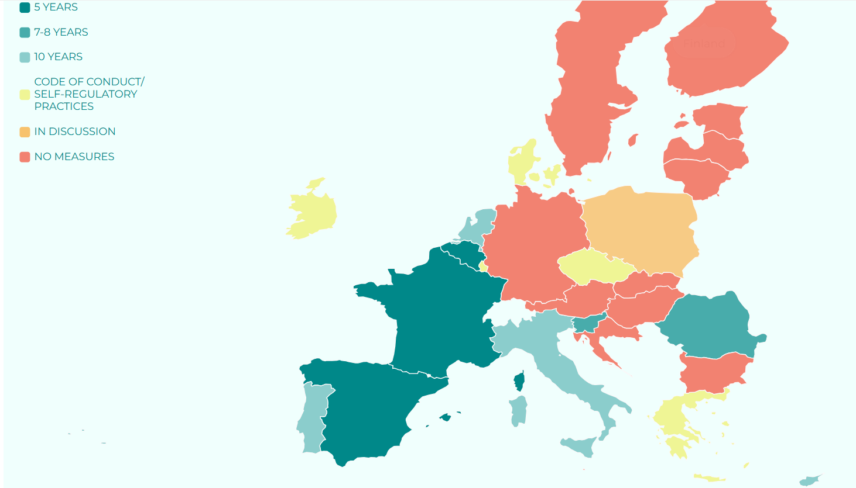
Overview of EU Member States’ Legislation on the RTBF

Slide 10
Initiatives at the EU level
Europe’s Beating Cancer Plan
Code of Conduct
The EU Cancer Mission (Horizon Europe)
Consumer Credit Directive
The Beating Cancer Plan

Slide 11
Becoming a cancer survivor:
a difficult journey with sunlight at the end
With new issues leading to…
Surviving cancer
Treatment of cancer
Cancer Diagnosis

Slide 12
What is needed?
Harmonised legal framework: EU legislation to protect all cancer survivors from financial discrimination
→ Building upon the experience of the current 9 EU Member States with a framework around the right to be forgotten and through the use of:
Innovative solutions for appropriate rehabilitation
Collection of long-term survival data
Harmonised national cancer registry at the EU level

Slide 13
How to act at national level?
Testimonials are powerful tools to entice politicians to take action
Identify someone to carry your message – a political champion
Get support from key oncologists that can further raise awareness

Slide 14
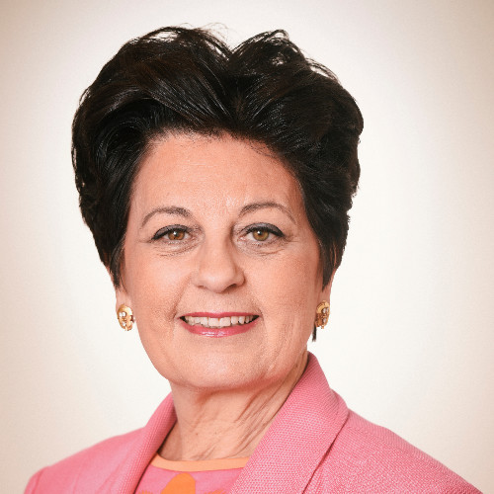
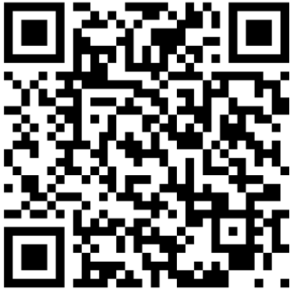
Get in touch with us
Prof. Dr. Françoise Meunier
​
Vice-President, Belgian Royal Academy of Medicine​​
Founder, Ending Discrimination Against Cancer Survivors​
LinkedIn: Françoise Meunier
Website: endingdiscrimination-cancersurvivors.eu​ Email: info@endingdiscrimination-cancersurvivors.eu​

