Slide 1





How to Work Well with National Governments and Health
HEMA-ONKO's Journey of Advocacy, Partnership & Reform in North Macedonia
HEMA-ONKO
Association dedicated to cancer patients and their caregivers
TOGETHER WE ARE STRONGER IN THE FIGHT AGAINST CANCER

Slide 2
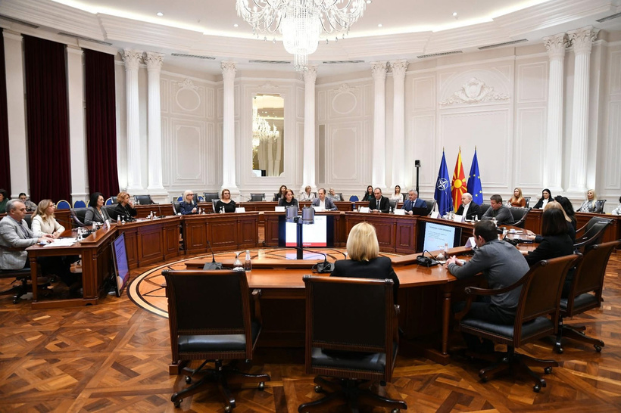
TOGETHER WE ARE STRONGER IN THE FIGHT AGAINST CANCER
“Trust is built with consistency.”
HEMA-ONKO
Association dedicated to cancer patients and their caregivers
A key way to establish trust is to be consistent in what we do and say.
Consistency builds trust, and inconsistency can quickly break it.

Slide 3


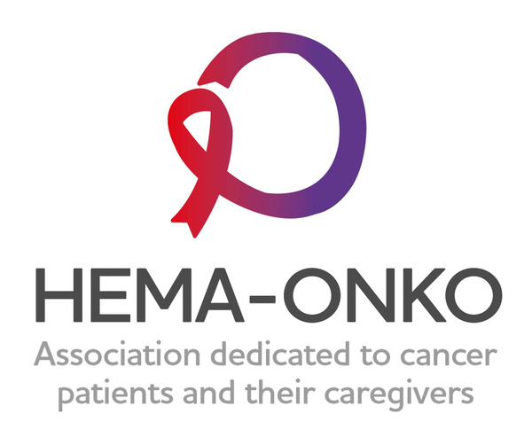
Who We Are – HEMA-ONKO
Founded in 2018 as HEMA, we were focusing on blood cancers in North Macedonia. The goal was to provide better access to life-saving treatments and ensure that patients had accurate information and support.
2018-2022: Building Trust & Expanding Reach
We started by building strong relationships with patients, doctors, and healthcare professionals, which formed the foundation of our advocacy efforts.
In 2022, we evolved into HEMA-ONKO, expanding to support all oncology patients—breast, lung, gastrointestinal cancers, and more.
Core Values:
  Patient-Centred Advocacy: Focused on the real-world experiences of patients to ensure their voices are heard in policy-making.
  Collaboration: Worked hand-in-hand with healthcare professionals to improve patient care.
  Trust and Consistency: Built a reputation over time as a trusted partner in healthcare.
  Impact Today: HEMA-ONKO is a trusted voice for oncology patients, working continuously for reforms in healthcare policies to ensure better access to modern therapies, early detection, and overall quality of care for cancer patients in North Macedonia.
TOGETHER WE ARE STRONGER IN THE FIGHT AGAINST CANCER

Slide 4




How We Got Involved
Our engagement began not because of a single event but because of persistent problems in the healthcare system that left many patients underserved.
We prioritised building strong relationships with patients, doctors, and clinical leadership.
HEMA-ONKO
Association dedicated to cancer patients and their caregivers
Through media outreach and public advocacy, we highlighted patient issues and amplified their voices.
By consistently presenting patient experiences and offering constructive solutions, we earned a seat at the table with policymakers.
  We positioned ourselves as experts in understanding real patient needs.

Slide 5
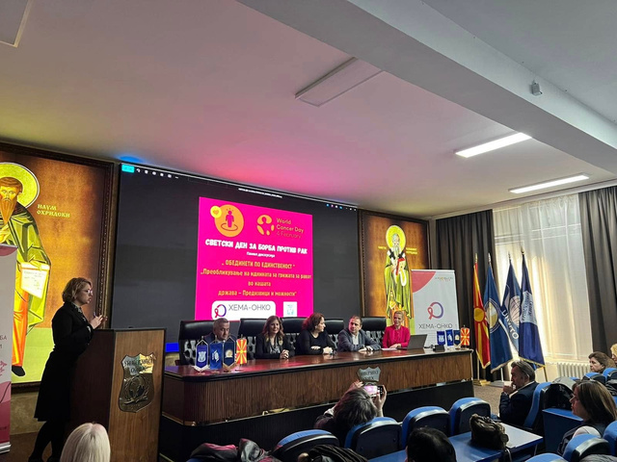
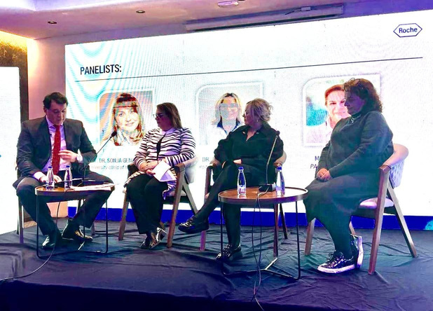
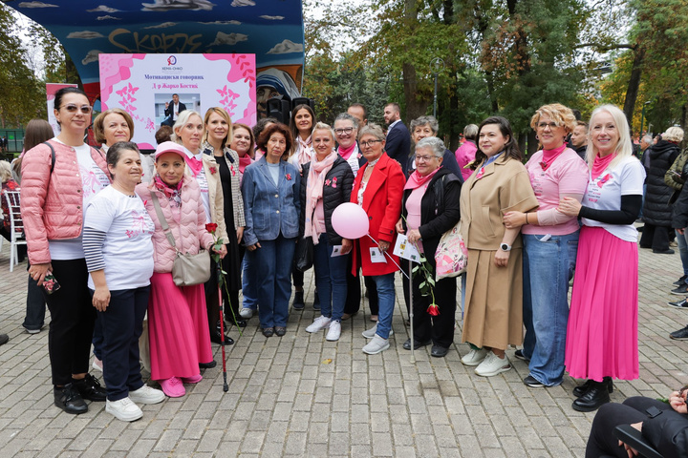
Key Actions & Milestones
  Hosted educational forums and workshops in partnership with hematologists and oncologists, often including government representatives.
  Actively participated in regional conferences, such as Hematology Days 2024 in Kosovo, where our president was the sole patient advocate on a high-level panel.
  Led public awareness campaigns using infographics and outreach in Macedonian and Albanian, educating the public on early detection and treatment.
  Held regular strategic meetings with the Ministry of Health and the Health Insurance Fund to present proposals and advocate for improvements.
  Took part in international projects like the Acute Leukemia Advocates Network to bring global insights home.

Slide 6







Strategic Alliances & Collaboration
HEMA-ONKO is a founding member of the Alliance for Better Healthcare in North Macedonia - NAPO. The Alliance includes several influential NGOs: Hepar Centre, Nefron, National Association for MS, Life with Challenges, Femina M, Sano, Union of Diabetes Associations, and others.
We work closely with key medical institutions:
  University Clinic for Haematology
  University Clinic for Radiotherapy and Oncology
  General Hospital "8th of September"
Our international partnerships, such as the Acute Leukemia Advocates Network, Myeloma Patients Europe, ECPC - European Cancer Patient Coalition, CLL Advocates Network (CLLAN) and many more we support advocacy and innovation.

Slide 7


Advocacy Goals
Strengthening awareness campaigns for early cancer detection
Improving screening programs to increase early diagnosis rates
Add innovative and life-saving treatments to the national reimbursement list
Establish and implement a comprehensive national cancer strategy.
Ensure faster and more accurate diagnostics, including PET scans and molecular testing.
Decentralize care so patients outside of Skopje can access treatment closer to home.
Develop and advocate for the HEMA-ONKO 2025 Cancer Plan as a long-term framework for patient-centered cancer care.

Slide 8





Achievements & Impact
Official adoption of the HEMA-ONKO 2025 Cancer Plan after months of consultation.
Oncology budget raised from 1.47 to 2.4 billion MKD (64% increase).
Haematology budget raised from 290 million to 450 million MKD (55% increase).
Subcutaneous therapies introduced, saving time and increasing access.
First-ever access to melanoma and prostate cancer biological treatments.
Intravenous therapy will be replaced with subcutaneous therapy, allowing patients to receive treatment closer to home - reducing administration time from more than an hour to just 10 minutes. Getting new treatment for breast cancer patients
Budget secured for breast reconstruction surgery and expanded radiotherapy services.
Expanded access to PET scans

Slide 9
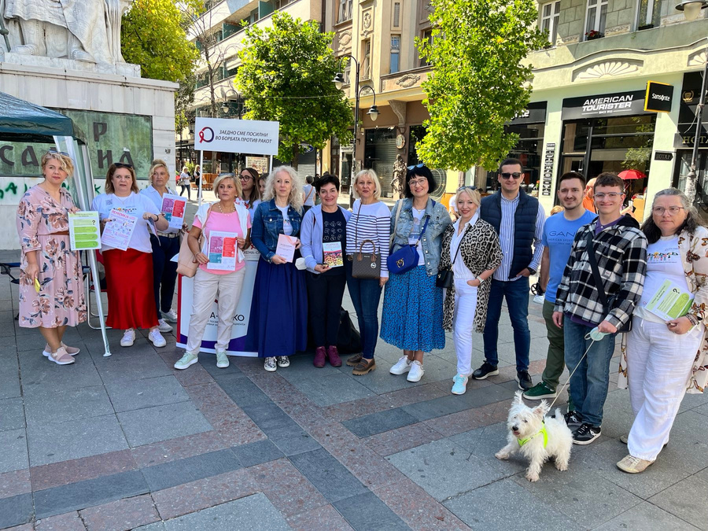
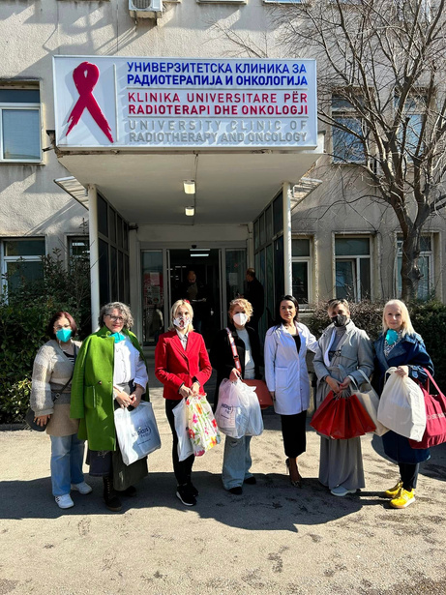
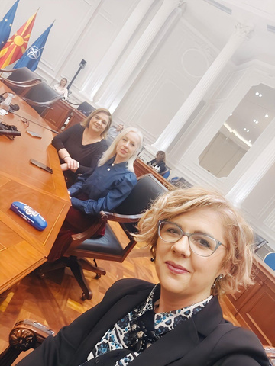
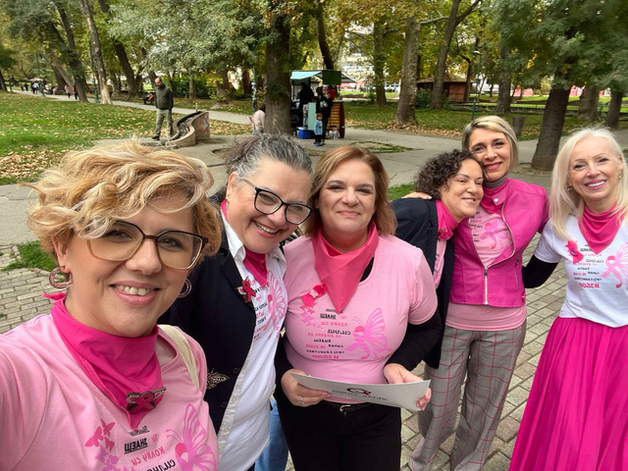

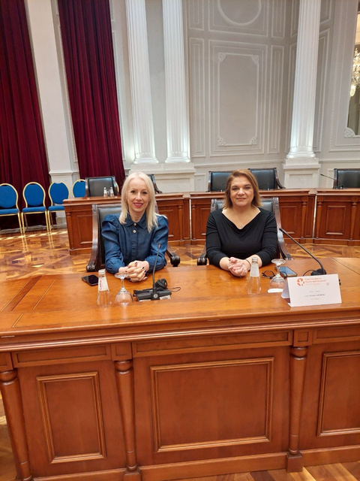
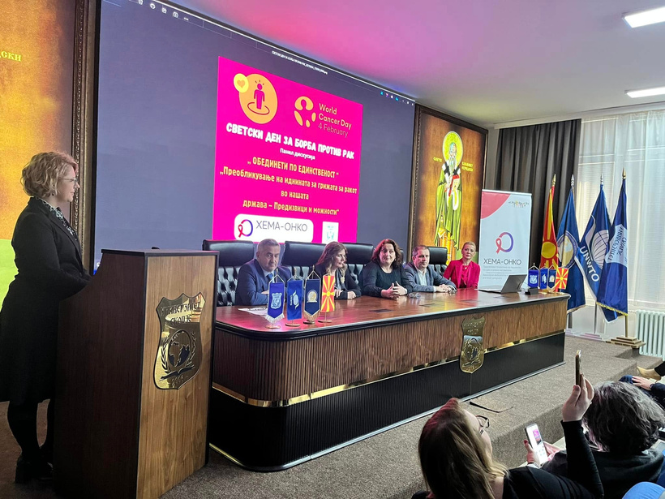
Role of Patient Organizations
  Patient groups like HEMA-ONKO bring authenticity and urgency to healthcare discussions.
  We ensure reforms are designed with the human impact in mind.
  Our participation bridges the gap between institutions and the everyday patient experience.
  We help governments prioritise real issues and track the outcomes of implemented policies.
  Our involvement enhances accountability, builds trust, and keeps healthcare centred on people.

Slide 10


What’s Next?
  Ensure full implementation of the HEMA-ONKO 2025 Plan by monitoring government follow-through.
  Continue awareness, screening, and education programs targeting early detection.
Strengthen regional advocacy networks and participate in cross-border initiatives.
Maintain pressure for systemic reform, independent of political changes.
Stay loyal to our founding mission: Supporting patients above all else.
HEMA-ONKO
Association dedicated to cancer patients and their caregivers

